Slide 1
LLM for Gen AI
Dr. Monali Mavani

Slide 2

Disclaimer and Acknowledgement
The content for these slides has been obtained from books and various other source on the Internet
I here by acknowledge all the contributors for their material and inputs.
I have provided source information wherever necessary
I have added and modified the content to suit the requirements of the course

Slide 3
Session Agenda
Preference-Tuning
LLM Preference Data
Reward Models
Modeling Preferences - Bradley-Terry (BT) model
RLHF for preference tuning
PPO-Proximal Policy Optimization
GRPO – Group Relative Policy Optimization
DPO - Direct Policy Optimization
Constitutional AI and RLAIF

Slide 4
Why is Instruction Tuning not enough?
Question: What’s the best way to lose weight quickly?
What to say? | What not to say?
Reduce carb intake, increase fiber s protein content, increase vigorous exercise | You should stop eating entirely for a few days
Instruction tuning can make this happen
But can’t prevent this from happening
Alignment can prevent certain outputs that the model assumes to be correct, but humans consider wrong.
Slide credit : IIT Delhi LLMs: Introduction and Recent Advances

Slide 5
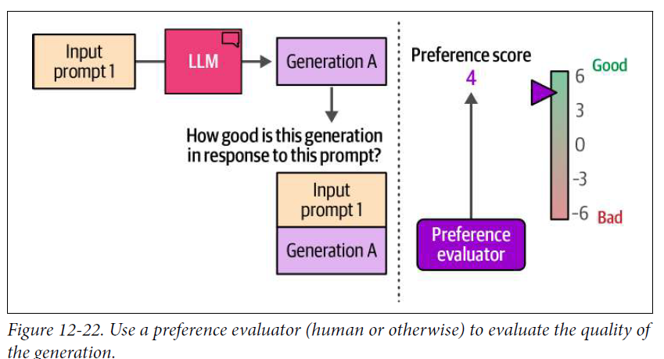
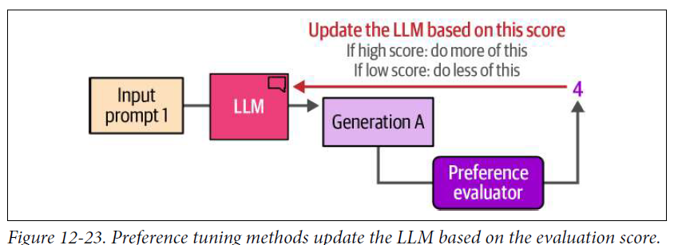
Preference-Tuning / Alignment / RLHF
If score is high, model is updated to encourage it to generate more like this type of generation
we need many training examples
Preference Evaluation can be automated by training a different model called a reward model.

Slide 6
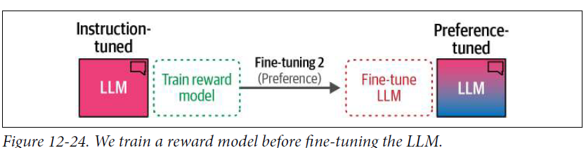
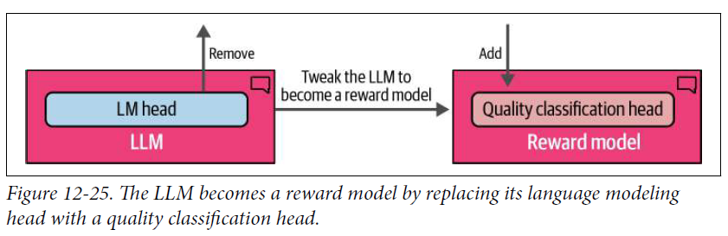
Automating Preference Evaluation Using Reward Models
Need a step before preference-tuning step, namely to train a reward model
To create a reward model, we take a copy of the instruction tuned model and slightly change it so that instead of generating text, it now outputs a single score

Slide 7
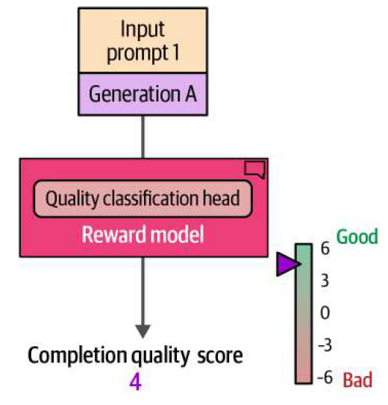
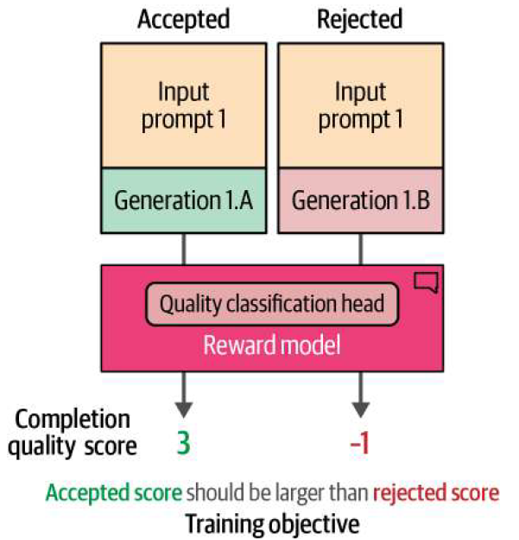
Reward Model
Training a Reward Model
Inputs and Outputs of a Reward Model
Training objective: to ensure accepted generation has a higher score than rejected generation
Use a reward model trained on human preference to generate the completion quality score

Slide 8
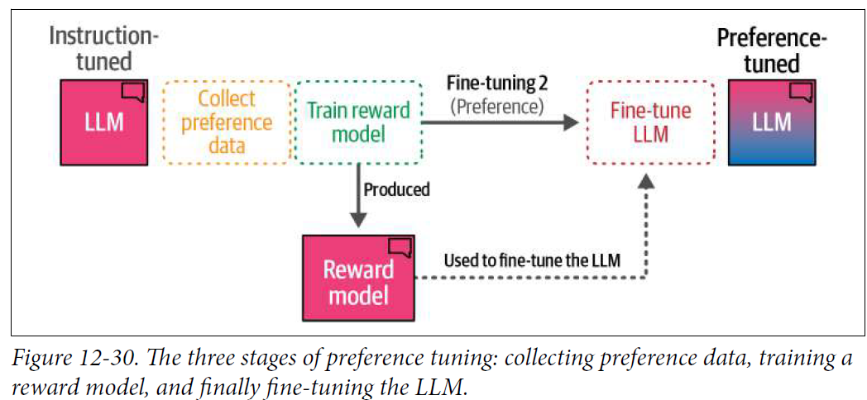
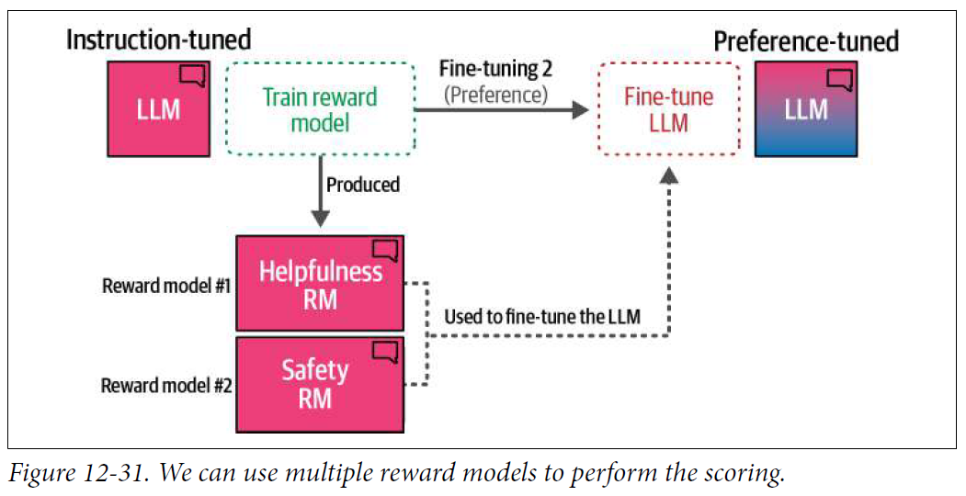
Preference tuning pipeline
1. Collect preference data
2. Train a reward model
3. Use the reward model to fine-tune the LLM (operating as the preference
evaluator)
Llama 2 trains two reward models

Slide 9
LLM Preference Data
  Prompt x paired with alternative outputs sampled from an LLM
  O_{w} → preferred output , O_{l} → not preferred output , we denote this as (o_{w} > o_{l} | x)
Three ways to collect preference pairs
          Direct annotation — annotator sees a pair and picks the winner. Yields 1 pair per task. Most precise; slow at scale.
          Model A > Model B
          Full ranking of N outputs — annotator orders all N responses from best to worst. Yields C(N, 2) pairs — for N = 4, that is 6 pairs. Maximum signal per unit of human effort.
      Annotator Ranking: D (Best), B (2nd), A (3rd), C (Worst)
      Data Generated (6 Pairs): D > B, D > A, D > C ,B > A, , B > C, A > C
          Selection of single preferred option — annotator picks only the best from N; the rest are unranked. Yields N − 1 pairs — for N = 4, that is 3 pairs. Faster than full ranking; less signal per task.
      Annotator Decision: "Response B is the best out of 4 answers."
      Data Generated (3 Pairs): B > A, B > C, B > D

Slide 10
Sources of Preference Data
Four ways to collect the (x, ow, ol) triples that drive alignment
Human annotator judgments — trained annotators pick winners from response pairs (InstructGPT), or rank sets of 4 outputs to yield 6 pairs each. Gold standard — precise, but slow and expensive.
Implicit web preferences — Reddit and StackExchange posts as prompts, replies as candidates, upvote counts as the ranking mechanism. Cheap and large-scale, but noisy.
Synthetic AI-judged preferences — sample answers from several LLMs; ask a stronger model (e.g., GPT-4) to rank them. Basis for datasets like UltraFeedback. Massive scale at low cost.
Scalar (Likert) judgments — annotators (human or LLM) rate outputs 0–4 on helpfulness, honesty, correctness, verbosity; average, then convert to pairs. Easy to collect, but subjective.
ULTRAFEEDBACK: Boosting Language Models with Scaled AI Feedback

Slide 11

Modeling Preferences - Bradley-Terry (BT) model
Bradley-Terry (BT) model is the mathematical engine behind how modern LLMs learn from human feedback
It solves a fundamental problem in AI alignment: How do you turn subjective human prefrence (ranking Response A > Response B) into a concrete number (reward score) that a computer can optimize?
BT model is a probabilistic model for pairwise comparisons
Learning can happen via Cross entropy loss
a prompt x and two candidate outputs o_{i},o_{j}

Slide 12

Learning to Score Preferences
We don’t have scores, z_{i} but we have collections of preference judgments over pairs of prompt/sample outputs
z_{i}=r(x,o_{i}) and z_{j}=r(x,o_{j})
We’ll use this preference data and BT reward formulation to learn a reward function, r(x,o) that assigns a scalar reward to prompt/output pairs.
This has the right behavior: if r(x,o_{i})≫r(x,o_{j}), the probability is near 1; if the scores are equal, the probability is 0.5.

Slide 13
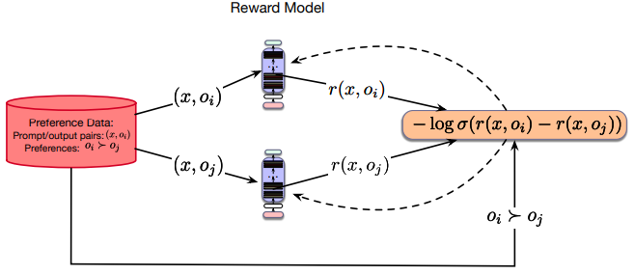
Learning to Score Preferences
Human preference pair (x, o_{w}, o_{l}) — o_{w} is the winner, o_{l} is the loser.
Model's predicted probability of the correct label:
P(o_{w} ≻ o_{l} | x) = σ( r(x, o_{w}) − r(x, o_{l}) )
Negative log-likelihood (binary cross-entropy) for a single pair:
ℓ = − log σ( r(x, o_{w}) − r(x, o_{l}) )
Use gradient descent to minimize a binary cross-entropy loss to train the model and learn r(x,o) from the preference data

Slide 14


Reward models (RMs) - example
→ Given a training example (x,o_{i},o_{j}) where humans prefer o_{i} ≻ o_{j}
Run the model twice to obtain scores r(x,o_{i}) and r(x,o_{j})
→ Suppose the current reward model outputs r(x,o_{i})=1.2, r(x,o_{j})=0.3
score difference is 1.2−0.3=0.9
→ Bradley–Terry probability that o_{i} is preferred is
→Pairwise loss (binary cross-entropy) for this example is
L=−log P(o_{i} ≻ o_{j} ∣ x) = −log (0.71) ≈ 0.34
→During training, the RM adjusts its parameters to reduce this loss — which means increasing r(x, oi) relative to r(x, oj) so that σ(score difference) gets closer to 1

Slide 15
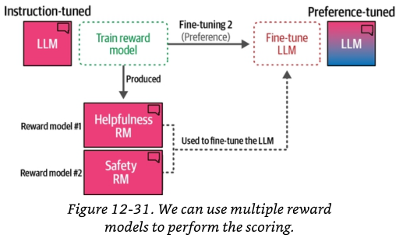
Multiple reward models
Uses of reward models
Best-of-N sampling — generate N responses, keep the highest-scoring one
Model alignment — the reward signal inside PPO and GRPO
Automated evaluation — a proxy for pairwise human preference during development
Llama-2 trains two reward models: one that scores helpfulness and another that scores safety
Ensembles of RMs reduce reward hacking, but cost proportionally more to train and serve

Slide 16
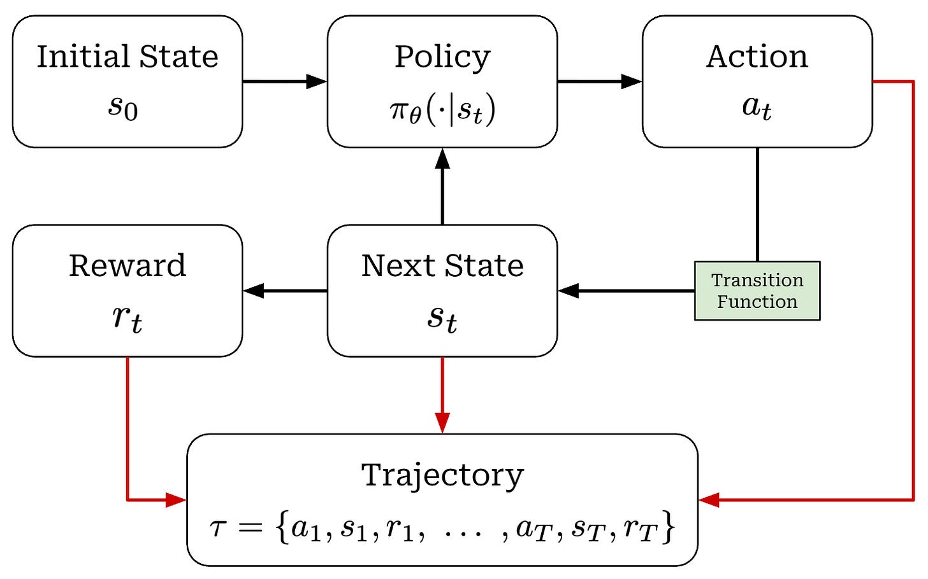
Reinforcement Learning (RL)
RL is a computational approach to learning through interaction.
The framework is a continuous cycle between two entities:
Agent and Environment
The policy is the function we want to learn.
Goal: find the optimal policy π*, the policy that maximizes expected return when the agent acts according to it.
We find π* through training.
https://cameronrwolfe.substack.com/p/ppo-llm

Slide 17
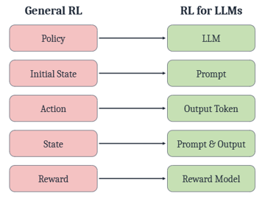
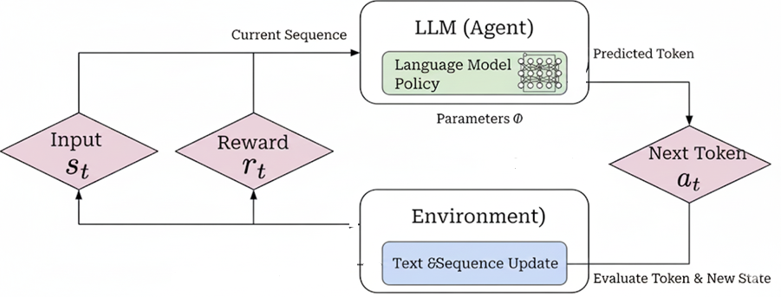
RLHF for preference tuning
State: LLM (Agent) looks at the Input so far (s_{t}), which includes the original user prompt and any words it has already written
Action: Based on its Policy (π_{θ}), the model calculates the Probability of the next token and selects a specific Next token (a_{t}) to generate
Transition: This new token is added to the sequence, creating a new "Environment" state for the next step
Feedback: Once the response is complete, the reward model scores it as a whole. That single number rates the entire generated response.
Optimization: LLM uses this response-level reward to adjust its parameters θ so that higher-scoring responses become more likely.

Slide 18
RLHF
RLHF is an LLM alignment pipeline that uses human preference signals to train a reward model and then optimizes the language model with reinforcement learning (commonly PPO) to produce outputs humans prefer.
Before RLHF begins, three things already exist:
A pretrained LLM — knows language from web-scale text. Has no particular preferences or instruction-following behavior.
An SFT model — the same LLM after instruction fine-tuning. Now follows instructions in the right format, but its judgment on which response is better is unreliable.
A preference dataset — triples (x, o_{w}, o_{l}) collected by human annotators. For each prompt x, humans indicated that o_{w} was preferred over o_{l}.
RLHF's job: use the preference dataset to turn the SFT model into an aligned model — one whose outputs humans genuinely prefer.
The pipeline has two steps.
SFT model is the parent. Both steps of RLHF begin by making a copy of it.

Slide 19
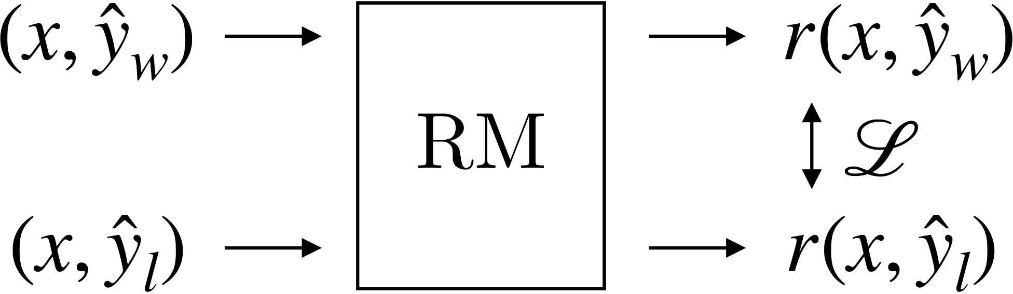
RLHF Step 1 — Reward Modeling
Goal: turn the preference dataset into a scoring function r(x, o) that assigns a scalar quality score to any (prompt, response) pair
How:
Start with the SFT model. Replace its next-token-prediction head with a new scalar output head. This is the reward model
For each preference triple (x, o_{w}, o_{l}), run the RM twice — once on (x, o_{w}), once on (x, o_{l})
Apply Bradley-Terry: P(o_{w} ≻ o_{l} | x) = σ(r(x, o_{w}) − r(x, o_{l}))
Train the RM's parameters to minimize ℓ = − log σ( r(x, o_{w}) − r(x, o_{l}) )
Once training ends, the reward model is frozen. It never changes again for the rest of RLHF.

Slide 20



RLHF Step 2 — Reinforcement Learning
Idea. Change weights of LLM to penalize bad answers and promote good answers
via Reinforcement Learning using the Reward Model.
I'd suggest you do not spend much time with your teddy bear at all.
Suggest a new activity I could do with my teddy bear.
Trained
Frozen
LLM
RM
via RL
Objective function optimizes for higher rewards without going too far from the
base model
"Training language models to follow instructions with human feedback", Ouyang et al., 2022.

Slide 21
RLHF Step 2 — Reinforcement Learning
Goal: update a language model so it produces responses the reward model scores higher.
Setup: make a second copy of the SFT model. Keep its next-token-prediction head — no scalar head this time. Call it the policy π_{θ}. This is what RL will modify.
One training iteration:
  Sample a prompt x from a large prompt pool.
  Generate a response — the current policy π_{θ} generates a full response one token at a time.
  Score the response — pass (x, complete response) to the frozen reward model. Get back one scalar r(x, response).
  Update the policy — nudge π_{θ's} parameters so higher-scoring responses become more likely, lower-scoring ones less likely.
Repeat for ~10⁵ prompts.
The policy learns from responses it just generated. That is what makes this reinforcement learning rather than supervised learning

Slide 22
Step 2 — Objective and PPO Algorithm
Data. O(100,000) prompts. Labels = scores from the frozen reward model.
Model. Policy π_{θ} initialized at the SFT model.
Training. Change the weights of π_{θ} via the objective function:
ℒ(θ) = [ Maximize rewards ] + [ Don't deviate too much from the base model ]
PPO (Proximal Policy Optimization)— the algorithm that optimizes this objective :
    Improve training stability by limiting how much π_{θ} can change per epoch.
    Measure the change via a ratio between the current and previous policies: r_{t(θ)} = π_{θ} / π_{θ_old}
    Clip the ratio to [ 1 − ε, 1 + ε ] — remove the incentive to move too far from the previous policy (hence "proximal").
    Alternatively — subtract an explicit KL penalty on the drift instead of clipping.
"Training language models to follow instructions with human feedback", Ouyang et al., 2022.

Slide 23
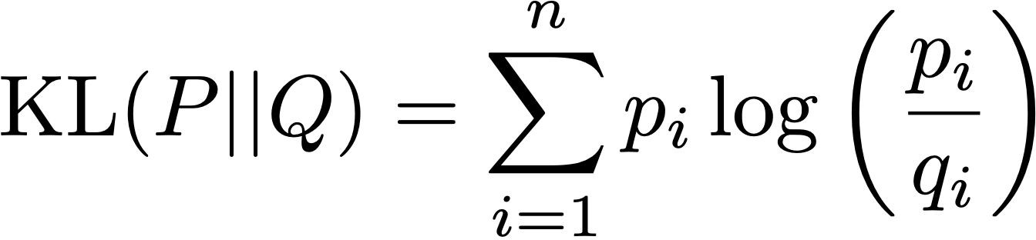

Maximize Reward Minus KL
Maximize rewards reward from the preference-trained reward model
subtract a KL penalty so π_{θ} does not drift too far from π_{ref} (the SFT/base LLM)
π_{ref} — frozen SFT model, "gold standard" for fluency and general knowledge.
KL divergence — distance between two probability distributions: "how different is the new model's writing style π_{θ} from the original π_{ref}?"
λ (or β) — the penalty weight. High: stay close to the original. Low: allow drift to chase higher reward.
PPO is the algorithm that optimizes this objective — with one important nuance: PPO does not use the reward directly. It uses advantages.
"Training language models to follow instructions with human feedback", Ouyang et al., 2022.

Slide 24
PPO — Advantages and the Clipped Objective
Advantage, not raw reward : A_{t} ≈ r_{t} − V(s_{t})
It measures whether a token was better than average, not just what score it got.
At each token position t, V(s_{t}) answers one question: "Given everything written so far, how good will the final response be?"
It is a learned neural network — trained jointly with the policy — that predicts the reward that the reward model will assign when the response is eventually complete.
PPO uses it as a baseline: if the actual reward turns out higher than V predicted, the tokens that led there get a positive advantage. If lower, they get a negative advantage.
It roughly doubles GPU memory (GRPO will delete this network)
Note that r_{t} here means the reward from the reward model — a scalar like 1.2 or 0.3. This is different from the r_{t}(θ), which was the ratio between the new and old policy probabilities. Same letter, different meaning — this is a notation collision in the literature

Slide 25
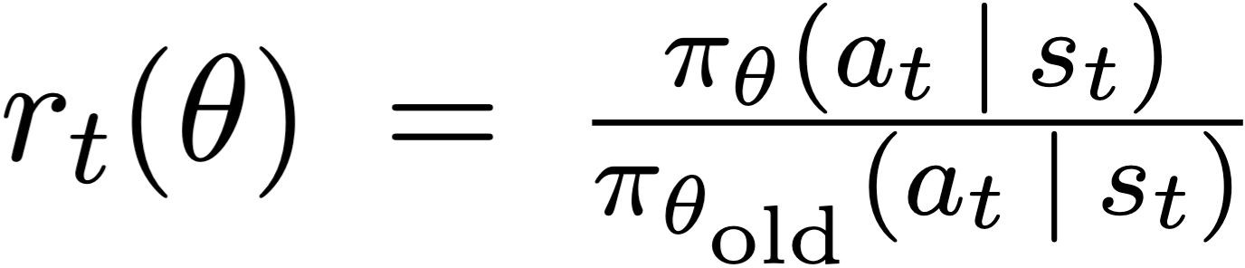
Variation 1: PPO-Clip -Clipped surrogate objective function
Idea. Clip ratio between new and old policy to prevent large updates
Terminology. Confusing since rewards noted "r". Here we are talking about the ratio.
Ratio function measures how much the model's behavior has changed during the current training update
If r = 1 → New model is acting exactly like the old model
  If r > 1 → new model is more likely to take this action
  If r < 1→ New model is less likely to take this action
Clip on r_{t} bounds distance from π_{θ_old} — policy from the previous training step. This is about training stability — no single update can move the policy too far.
"Proximal Policy Optimization Algorithms", Schulman et al., 2017.

Slide 26
Variation 1: PPO-Clip
Idea. Clip ratio between new and old policy to prevent large updates
with
Terminology. Confusing since it is an objective function ("maximize") and NOT a loss.
Intuition: “Move π_{θ} toward actions with positive advantage, but if the probability ratio changes by more than ±ϵ, stop increasing the objective for that sample.”
"Proximal Policy Optimization Algorithms", Schulman et al., 2017.

Slide 27
Variation 2: PPO-KL Penalty
Idea. Penalize difference in policy distributions
old = model from previous RL iteration
ref = base model
Explicit KL penalty: The second term subtracts β KL(π_{θref} ∥ π_{θ}), which directly penalizes the whole distribution drifting too far from the old policy; β controls the strength of this penalty.
Intuition: “Do standard policy gradient on the ratio–advantage term, but also pay a ‘distance tax’ proportional to the KL between old and new policies.”
"Proximal Policy Optimization Algorithms", Schulman et al., 2017.

Slide 28
Preference tuning using PPO
Preference data
Reward model
train
Outputs
Scores
Instruction tuned model
Policy model
PPO
copy
update
Train a reward model on preference data. Architecture: SFT model with its next-token head replaced by a scalar reward head — sometimes a smaller sibling of the SFT model to save compute.
Copy the SFT model to serve as the policy model. This is what PPO will update.
The policy generates a response for each prompt. The frozen reward model scores that response.
Fine-tune the policy using PPO.
During PPO, both the reward model and π_{ref} stay frozen. Only the policy π_{θ} is updated.

Slide 29
Alternatives of PPO
Limitations of PPO
Needs 4 models — policy, value, reward, base
Slow on-policy training — the model generates from its current policy at every step
Not clear that preference tuning absolutely needs RL
Two ways forward
DPO — removes the reward model and the RL loop entirely
GRPO — keeps the clipped objective and the KL penalty; removes only the value network, using a group baseline instead
… and many more (IPO, KTO, ORPO, SimPO, RLAIF, Constitutional AI)
"DeepSeekMath: Pushing the Limits of Mathematical Reasoning in Open Language Models", Shao et al., 2024.

Slide 30
GRPO — Group Relative Policy Optimization
Same PPO objective. Same reward maximization, same β·KL(πθ ‖ πref) against the frozen SFT model. What changes is how the advantage A_{t} is computed
Change. Replace the value network V with the mean reward over a group of G responses sampled for the same prompt. No critic to train.
Recipe (one update):
  Sample G responses y₁, …, y_{G} per prompt from π_{θ} (G ≈ 8–64)
  Score each response: r(x, y_{i}) — from a reward model or a verifier
  Compute the group-relative advantage:
  A_{i} = ( r_{i} − mean(r₁, …, r_{G}) ) / std(r₁, …, r_{G})
  Every token in y_{i} is assigned advantage A_{i}. Apply the standard PPO update with β·KL against π_{ref}.
Payoff 1 — Memory : No value network to train or serve. GPU memory drops from 4× model size to roughly 3× —reference, reward source, policy
Reference: Shao et al., 2024 — DeepSeekMath: Pushing the Limits of Mathematical Reasoning in Open Language Models.

Slide 31
GRPO — Worked Example
Prompt x: "What is 17 × 24?"
Verifier: r = 1 if the final answer is 408, else 0
Step 1 — Sample G = 4 responses from π_{θ} and score each
Step 2 — Group statistics: mean(r) = 0.5 std(r) ≈ 0.5
Step 3 — Advantage: A_{i} = ( r_{i} − 0.5 ) / 0.5
Step 4 — What the update does
Every token in y₁ and y₂ gets advantage +1.0 → π_{θ} pushes their log-probs up
Every token in y₃ and y₄ gets −1.0 → π_{θ} pushes their log-probs down
The clip (from PPO) keeps individual token updates bounded; the KL term keeps π_{θ} near π_{ref}
Response | Final answer | r_{i} (verifier) | r_{i} − mean(r) | A_{i}
y₁ | 408 ✓ | 1 | +0.5 | +1.0
y₂ | 408 ✓ | 1 | +0.5 | +1.0
y₃ | 388 ✗ | 0 | −0.5 | −1.0
y₄ | 428 ✗ | 0 | −0.5 | −1.0

Slide 32
Why GRPO Matters — RLVR and Reasoning Models
Two payoffs that explain why GRPO powered every open-weight reasoning model of 2024–25
Payoff 2 — reward can be a program: GRPO does not care where r(x, y) comes from.
For math, code, and formal proofs a verifier is available: numeric checks, unit tests, Lean.
the verifier is ground truth.
Is 408 the answer to 17×24? Yes or no. There is no "sort of" answer.
Do the unit tests pass? Yes or no.
Does Lean accept the proof? Yes or no.
RLVR — Reinforcement Learning with Verifiable Rewards
This is the name for the combination: GRPO as the optimizer, a program-based verifier as the reward source. No reward model at all in the loop.
Model | How GRPO is used
DeepSeek-Math | GRPO + RLVR — paper that introduced algorithm
DeepSeek-R1-Zero | Pure GRPO + RLVR from a base model, no SFT — emergent chain-of-thought reasoning
DeepSeek-R1 | SFT → GRPO with RLVR for reasoning → SFT → GRPO with RM for chat
Qwen-QwQ | Adds GRPO with RLVR on math and code on top of chat alignment
AIML ZG536 · Preference Alignment

Slide 33
Direct Preference Optimization: Your Language Model is Secretly a Reward Model
DPO (Direct Preference Optimization): Skip the explicit reward model and finetune directly on the preference data
DPO is a preference-based SFT method that aligns LLMs with human values by directly optimizing the model's policy based on pairwise preference data
Framework | Model 1 | Model 2 | Model 3 | Model 4
PPO-RLHF | Policy Model π_{θ} (trainable) | Value Function Model (trainable) | Reward Model r_{ϕ} (trainable) | Reference Policy π_{ref} (frozen)
DPO | Policy Model π_{θ} (trainable) | Reference Model π_{ref} (frozen) | — | —

Slide 34
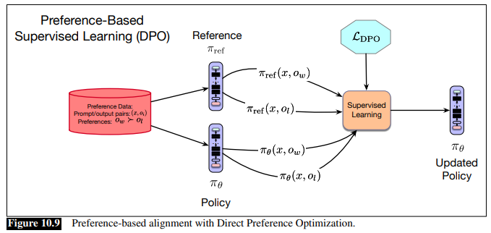
DPO Training - supervised learning
Start with preference data (x, ow, ol) — same pairs used in RLHF, no reward model needed
Load two models: π_{ref} (frozen SFT model, never updated) and π_{θ} (policy being trained)
For each triple, run four forward passes — π_{ref} and π_{θ} each score both o_{w} and o_{l}, producing four log-probabilities
Compute the DPO loss — it compares how much more the policy favors o_{w} over o_{l}, relative to what the reference model already assigned
Backprop through π_{θ} only — push o_{w} log-prob up, push o_{l} log-prob down, relative to π_{ref} Repeat over all preference pairs using standard minibatch gradient descent

Slide 35



DPO Loss Function
BT prob model:
DPO derives that the optimal reward can be expressed as
Π_{θ} → optimal policy which initialized with an existing pretrained, finetuned LLM
π_{ref} → reference (initial) model
β → hyperparameter that controls penalty term; typically range from 0.1 to 0.01
Z(x) → intractable normalizing constant.
Substituting back into BT model, normalizing constant cancels out:

Slide 36


DPO Loss Function
Loss is likelihood of a preference pair in terms of the two LLM policies, rather than in terms of an explicit reward model
CE loss (negative log likelihood) for a single instance is
Loss over the training set D is

Slide 37
PPO Vs DPO Vs GRPO
Framework | Model 1 | Model 2 | Model 3 | Model 4
PPO-RLHF | Policy πθ (trainable) | Value function Vψ (trainable) | Reward model rφ (frozen) | Reference πref (frozen)
DPO | Policy πθ (trainable) | Reference πref (frozen) | — | —
GRPO | Policy πθ (trainable) | Reference πref (frozen) | Reward model rφ (frozen) or verifier | —

Slide 38
Constitutional AI (CAI)
Replace human harmlessness labels with a written constitution
Motivation
Human labelling of harmful outputs is slow, expensive, and psychologically costly
Guidelines already exist in text — encode them explicitly and let the model apply them
What a 'constitution' is
A short list of natural-language principles used as critique / revision prompts during training. Examples:
"Choose the response that is most helpful, honest, and harmless."
"Do not provide instructions for illegal activity."
"Prefer the response that acknowledges uncertainty when knowledge is limited."
Constitutional AI: Harmlessness from AI Feedback

Slide 39
Constitutional AI — Two Phases
Phase 1 — SL-CAI (self-critique + revision)
  Prompt the base model with a harmful query
  Ask it to critique its own answer using a constitutional principle
  Ask it to revise the answer to remove the flaw
  Fine-tune (SFT) on the (prompt, revised answer) pairs
Phase 2 — RL-CAI (RLAIF)
Generate response pairs for many prompts
AI judge picks the preferred response using constitutional principles
Train a reward model on these AI-generated preferences
Run PPO (or DPO / GRPO) against that reward model

Slide 40
RLAIF — RL from AI Feedback
Whenever a human would label a preference pair, ask a strong model instead
Mechanism
Judge model reads (prompt, response A, response B) plus a rubric
Outputs a preference — used exactly like a human label
Judge can be a stronger model, a fine-tuned critic, or an ensemble
Preferences feed the same RM → RLHF / DPO / GRPO pipeline
Trade-offs
Orders of magnitude cheaper than human labels; consistent — no annotator drift
Coverage — can label 100× more prompts
Judge inherits its own biases — systematic errors, not random noise
Google's RLAIF paper: matches RLHF quality on summarization.

Slide 41
What Real Models Actually Do (2024–2026)
The recipes have converged on multi-stage pipelines
Model | Post-training pipeline
Llama-3-Instruct | SFT → Rejection sampling → DPO (multi-round). No PPO.
DeepSeek-R1 | SFT → GRPO with RLVR (reasoning) → SFT → GRPO with RM (chat)
DeepSeek-R1-Zero | Pure GRPO + RLVR from base model — no SFT. Proof of concept.
Qwen-2.5-Instruct | SFT → offline DPO → online DPO with self-generated pairs
QwQ / reasoning Qwen | Adds RLVR-style RL on math and code on top of chat alignment
Claude family | Constitutional AI + RLAIF + RLHF-style preference training
Mistral / Mixtral Instruct | SFT → DPO
Pattern: DPO for chat quality, GRPO+RLVR for reasoning, RLAIF / CAI to scale supervision. PPO is now the exception, not the norm.

Slide 42
Which Method ?
If the answer is machine-verifiable
Use GRPO + RLVR — math, code, formal reasoning, schema-constrained output
If you have preference pairs and constrained compute
Use DPO (or ORPO) — the default for chat alignment in 2026
If you have deep compute
Use RLHF (PPO) or GRPO with an RM — only if you can afford four models and a full ML-Ops loop
If the goal is harmlessness or auditable behavior
Use Constitutional AI + RLAIF — write the target as a constitution, scale supervision with an AI judge

Slide 43
Refrences
Ch-10 Speech and Language Processing By Jurafsky and Martin, Aug 2025 edition
https://huggingface.co/blog/deep-rl-ppo
https://cme295.stanford.edu/
Research Papers
  ULTRAFEEDBACK: Boosting Language Models with Scaled AI Feedback
  Direct Preference Optimization: Your Language Model is Secretly a Reward Model
  DeepSeekMath: Pushing the Limits of Mathematical Reasoning in Open Language Models.

